Slide 1
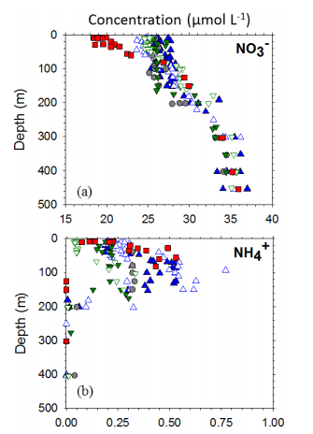
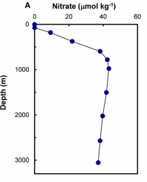
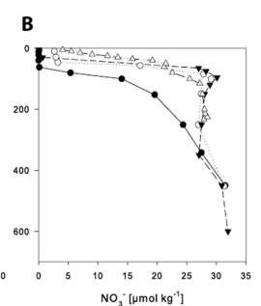
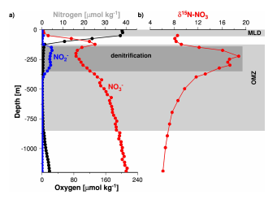
concentration |  | now uM | Before uM
NO3 | P | 11 | 11
 | D | 15 | 18
 | S | 18 | 16
 | DP | 35 | 35
NH4 | P | 0.4 | 1.2
 | D | 0.2 | 0.6
 | S | 0.1 | 0.5
 | DP | 0.01 | 0.3
Nitrate concentration data in the literature
A
B
C
D

Slide 2
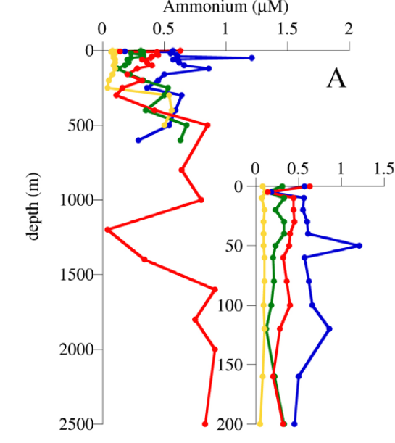
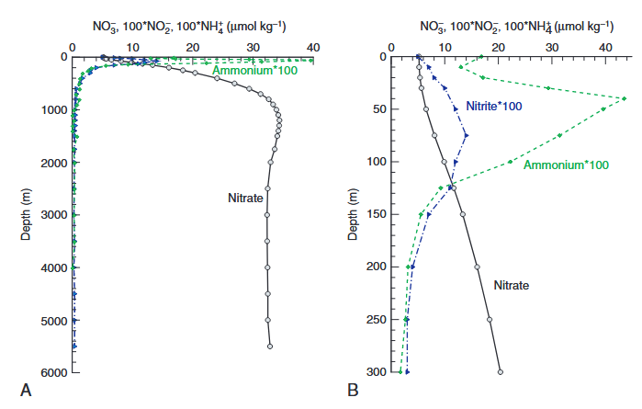
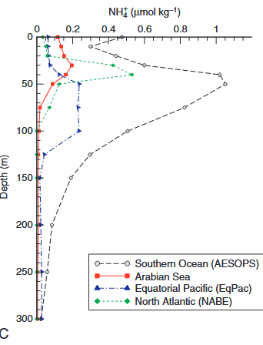
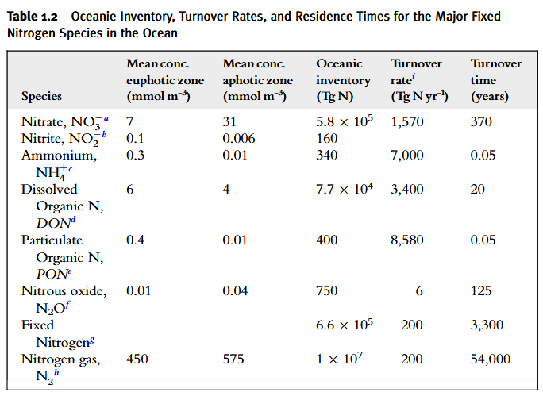
NH4 concentration data in the literature
concentration |  | now uM | Before uM
NO3 | P | 11 | 11
 | D | 15 | 18
 | S | 18 | 16
 | DP | 35 | 35
NH4 | P | 0.4 | 1.2
 | D | 0.2 | 0.6
 | S | 0.1 | 0.5
 | DP | 0.01 | 0.3
B
A
C
C
C

Slide 3
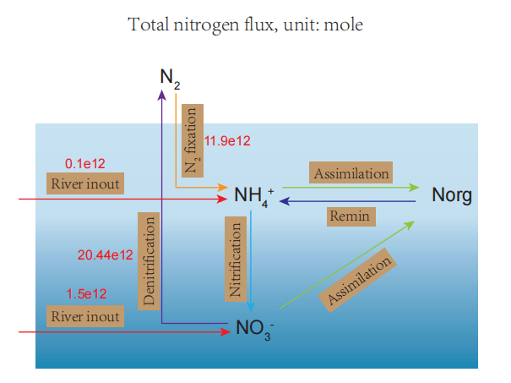
Key process parameter
 |  | Our model | Other study
Nitrogen fixation | P | 9E+11
 | D | 1E+12 | 1.07E+12
 | S | 1E+13 | 1E+13
Nitrification | P | 1.11E+12
 | D | 1.51E+13
 | S | 4.1E+14
 | DP | 8.1E+13
Denitrification | P | 1.1E+12
 | D | 6.1E+12 | ca. 7.14E12
 | S | 5.2E+12 | ca. 4.64E12
 | DP | 7.941E+12 | ca. 7.78E12
Total primary production N |  | 6.73744E+14 | 5.64-6.28E14
Total mineralization N |  | 6.73744E+14 | 75-97%TPP
Total N |  | 4.70E+16

Slide 4

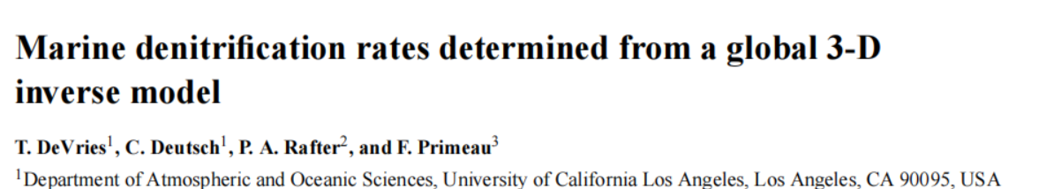
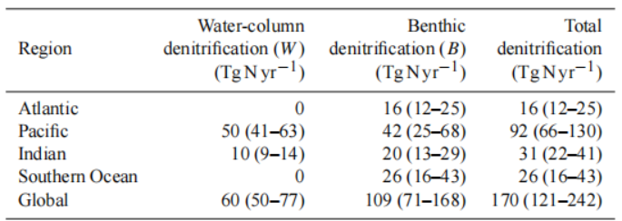
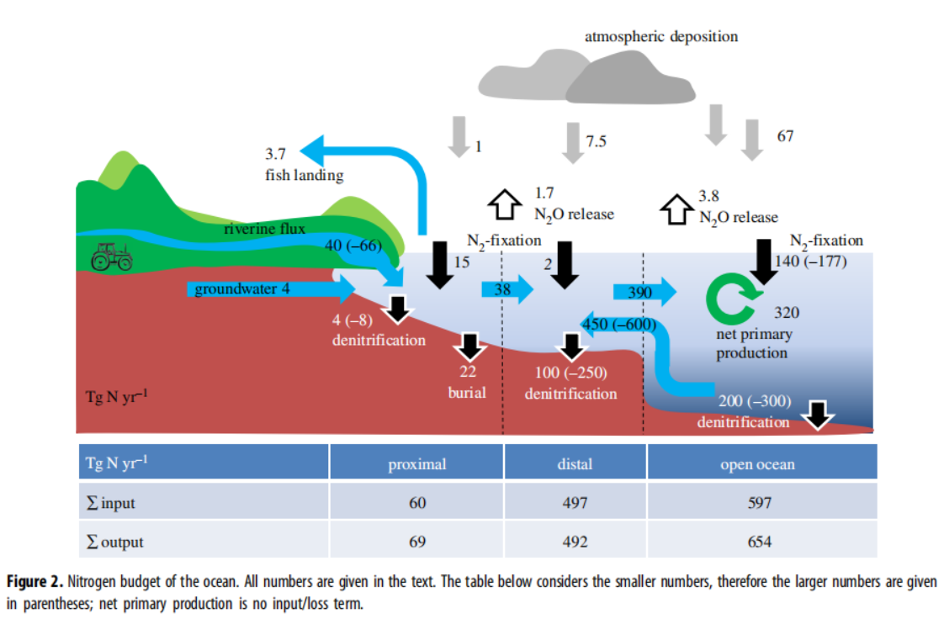
NH4_Nfix_P =15 Tg N/yr / 14= 1.07e12 mol N/yr
NH4_Nfix_D =2 Tg N/yr / 14= 0.14e12 mol N/yr
NH4_Nfix_S = 140 Tg N/yr / 14 = 10e12 mol N/yr
NO3_denit_P = 4 Tg N/yr / 14= 0.29e12 mol N/yr
NO3_denit_D = 100 Tg N/yr / 14= 7.2e12 mol N/yr
NO3_denit_S = 60 Tg N/yr / 14= 4.28e12 mol N/yr
NO3_denit_DP = 110 Tg N/yr / 14= 7.85e12 mol N/yr

Slide 5
